Slide 1
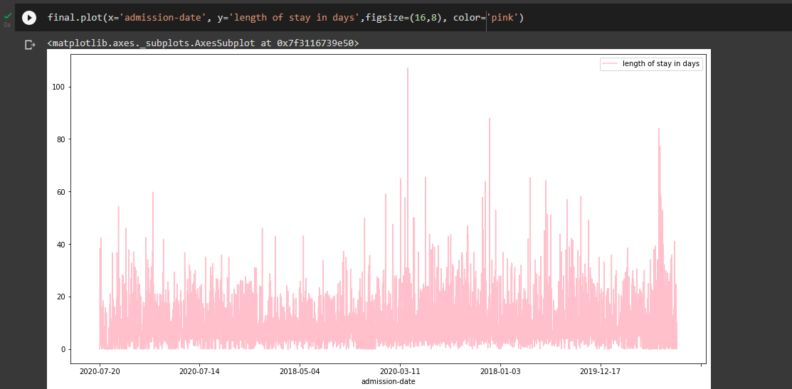
Clinical Data Analysis and Predictions
Comparison between the actual data and the predicted data
max patients
A Predictive Engine that predicts the number of patients who would get admitted on a particular day, with a particular disease.
max patients
Predicted
Actual

Slide 2
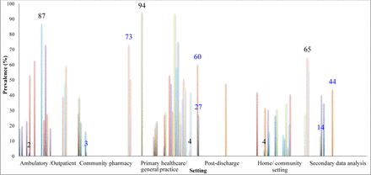
The Challenge
Problem statement
Context
Solution
1. According to a Harvard study, 5.2 million medical errors occur in India annually. What are its adverse impacts and how are these tackled?
2. Medical errors can be caused due to many reasons, including communication problems, inadequate information flow, ill-managed staffing, just to name a few.
1. With nearly 5,000,000 Indians dying due to medical management negligence every year.
2. Experts claim that a specialised technology for doctors and hospital staff focusing on how the trends in patients’ visits and how severe would be the disease would be, could bring down the figure by almost 50 per cent.
1. A service that predicts the number of patients who would get admitted on a particular day, with a particular disease. So that medical staff can be prepared and work accordingly.
2. AI powered technology that could help medical institutions become efficient in treating patients.

Slide 3
Solution
Data : 1. ICD codes 2. OPS codes 3. Case sum 4. Admission Date and Time 5. Length of days 6. Clinic Names
Technology Used:
TensorFlow for LSTM Neural networks.
Keras for implementing lstm.
FBProphet in contrast to lstm.
A Deep Learning Model
&
FBProphet for Time Series Analysis

Slide 4
ALGORITHM
Import required datasets, modules and merge the datasets and create a DataFrame using pandas.
Feature Engineering: Label encode the categorical data, Extract critical features.
Test the modules using the test DataFrame and compare the scores/results. Conclude and summarize.
Step 1
Step 2
Step 3
Step 4
Step 5
Data Analysis: Analyse the patients’ visiting trends with respect to various parameters.
Split the DataFrame into Train and Test Dataframes. Train different models such as LSTM, Autoencoders and FBProphet with the prepared Train DataFrame.

Slide 5
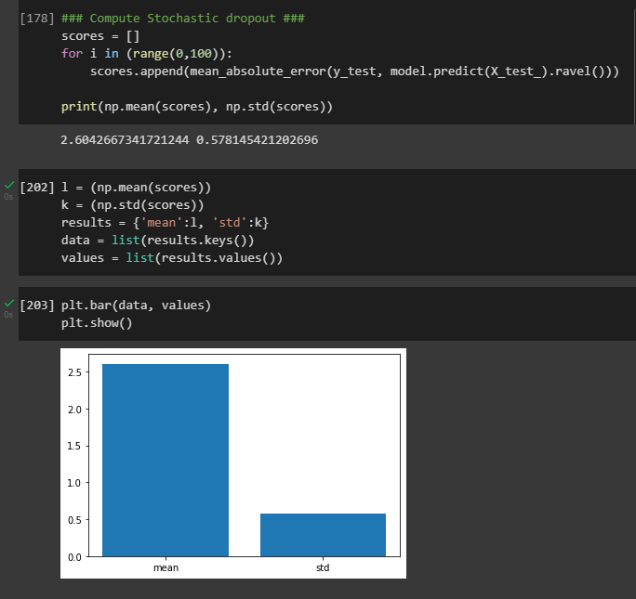
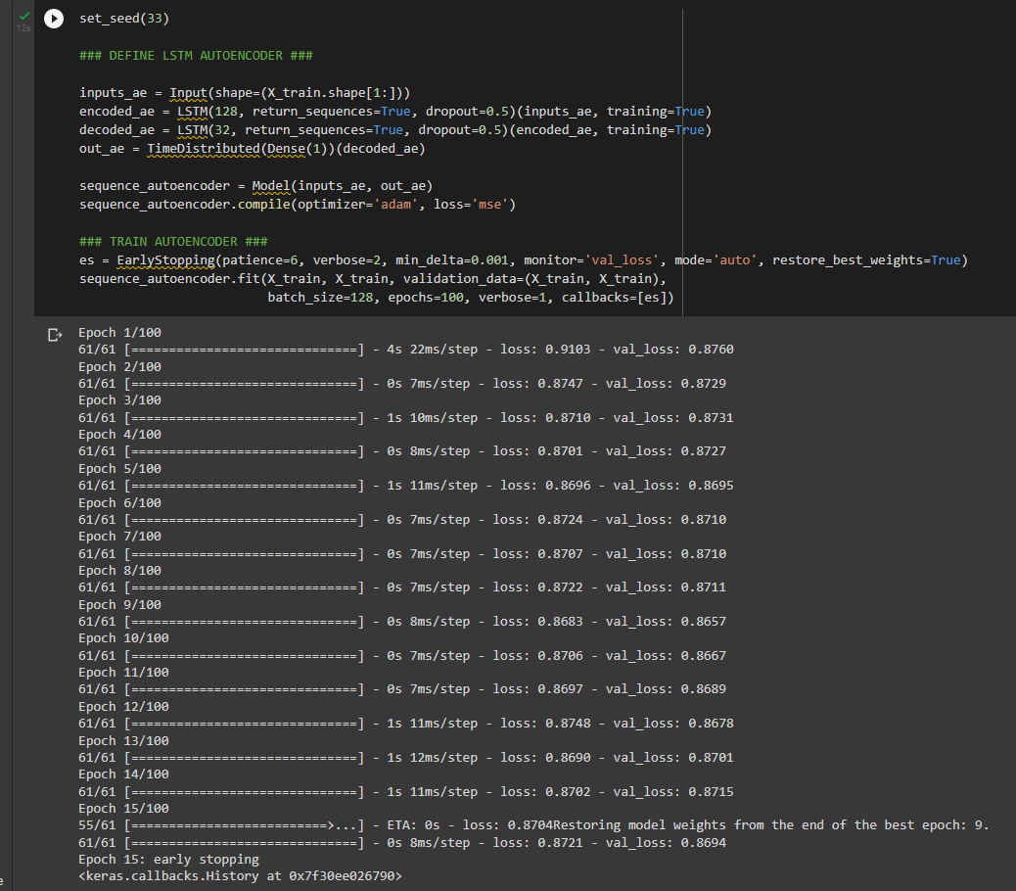
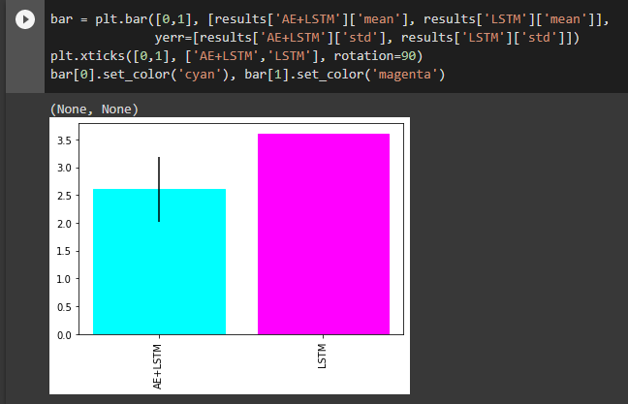
Implementation

